Slide 1


PREDICTIVE ANALYTICS FOR
DATA SCIENCE
GROUP - 4

Slide 2


OUR TEAM
Sriram Ganeshalingam SXG240054
Rukmangada RXX230010
Syed Muhammad Taqi Rizvi SXR240010
Prathik Raju PXR230052
Shreyas Harish SXH240028
Namratha Puchakayala NXP240017

Slide 3





Table Of Contents
Introduction
Market Analysis
Analysing Data
Insights
Project Overview
Category Introduction
Understand The Market
Know Your Competition
Seasonal Insights & Trends
Visualizations
Recommendations
References

Slide 4

INTRODUCTION
Objective:
To analyze buyer behaviors and key sales drivers within the meat substitute category, with a focus on Conagra’s product portfolio, in order to inform strategic growth opportunities.
Regression Modeling:
Modeled Unit Sales drivers using LASSO to identify high-impact features.
Compared overall market vs. Conagra-specific drivers (e.g., form factor, packaging, distribution).
Persona Profiling:
Segmented buyers - household size, income, age, marital status, and kids presence.
Strategic Synthesis:
Highlighted actionable insights to optimize product mix, distribution, and targeting.
Delivered clear recommendations for Conagra’s future growth

Slide 5

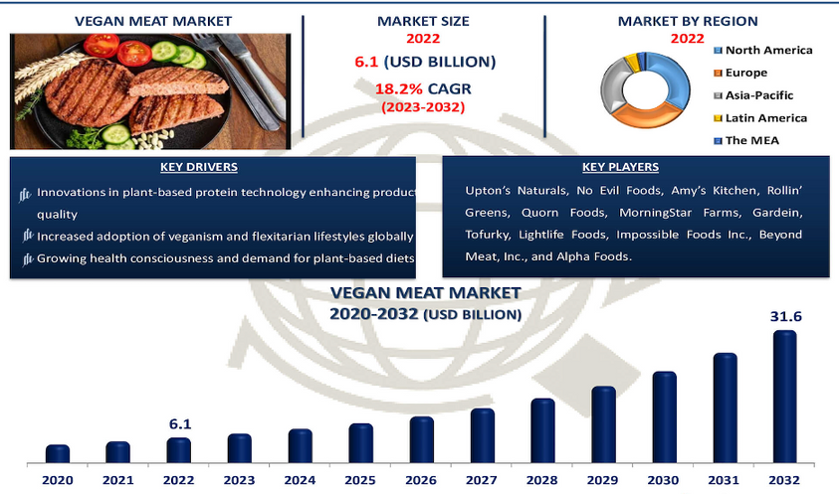
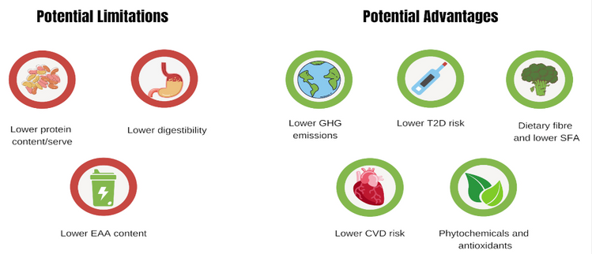
CATEGORY INTRODUCTION
MEAT SUBSTITUTES MARKET
About the Category
Rapidly growing segment driven by increasing consumer demand for sustainable and healthy food choices.
Attracts a wide demographic: vegans, vegetarians, flexitarians, and health-conscious consumers.
Industry Trends & Opportunities
Rising focus on environmental impact, animal welfare, and health benefits.
Growing demand for convenient, tasty, and affordable plant-based options.
Strategic opportunity for Conagra to accelerate growth and optimize its brand portfolio in this space.

Slide 6
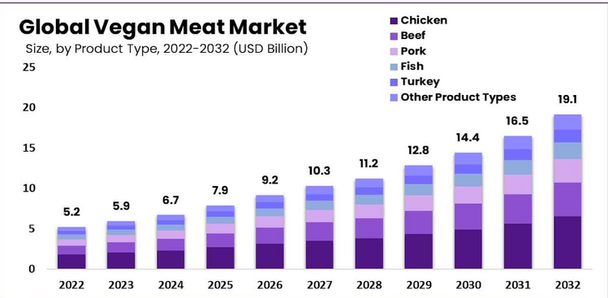
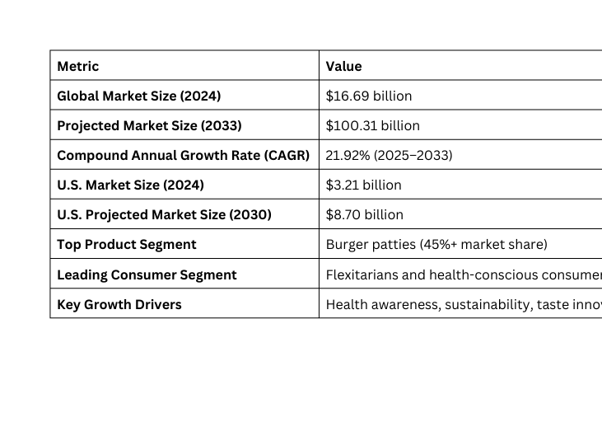
MARKET ANALYSIS
Market Growth Drivers
Rising consumer shift towards sustainable, ethical, and health-conscious choices.
Growing popularity of plant-based products like burgers, sausages, seafood, and vegan bacon.
Emerging Segments & Challenges
Vegan Bacon: Fast-growing segment, but taste and texture optimization remains a challenge (e.g., Gardein consumer feedback).
Flexitarians & Gym-Goers: Key growth audience, yet concerns exist regarding:
Plant protein digestion and bioavailability.
Amino acid spiking and health implications.
Consumer Insights
40% of shoppers bought plant-based meat/dairy in last 6 months — but only 10% follow fully plant-based diets.
86% of meat substitute buyers also buy conventional meat, indicating these products complement diets rather than replace meat entirely.
Market Trends & Future Outlook
Packaging and presentation are increasingly important.
Plant-based meat market projected at $16.7B in 2024, compared to $1.43T global meat market — huge growth potential.
Health & wellness trends + COVID-19 pandemic have accelerated demand for plant-based options.

Slide 7
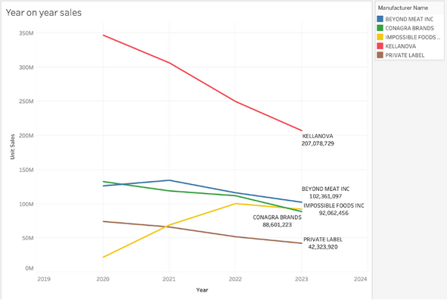
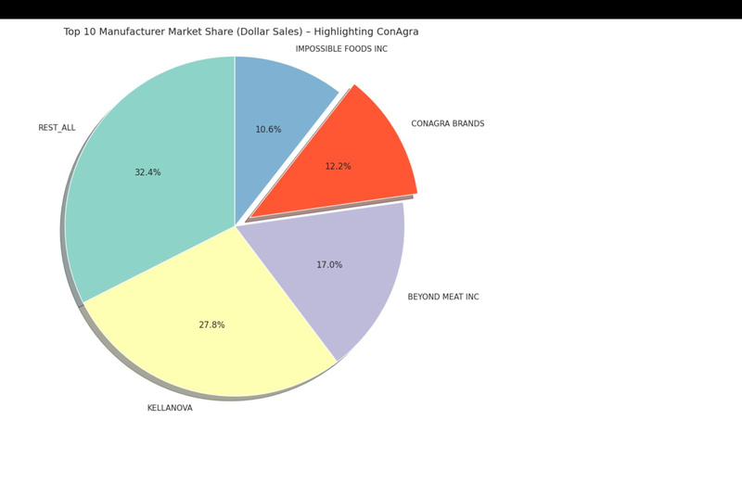
KNOW YOUR COMPETITION
Gardein (Conagra Brands)
Diverse offerings: From filets and tenders to soups and seafood alternatives.
Nutrient-rich ingredients: Ancient grains, non-GMO soy, low saturated fat, and zero cholesterol.
Morningstar Farms (Kellogg)
Established & trusted: Operating since 1974 with wide brand recognition.
Consumer appeal: 73% brand awareness; positioned as natural and tasty, not just meat substitutes.
Beyond Meat
Innovative leader: Famous for products mimicking beef (e.g., Beyond Burger).
Science-backed positioning: Partnered with ACS for health research
Target audience: Not only vegans/vegetarians but also flexitarians and meat-eaters.
Impossible Foods
Sustainability champion: Massive resource savings (96% less land, 91% fewer emissions).
Restaurant presence: 17,000+ locations including Burger King and White Castle.
Key Competitive Focus Areas
Taste & texture optimization
Protein quality and health benefits (esp. for gym-goers and flexitarians)
Sustainability and ethical production
Brand recognition and restaurant/retail presence

Slide 8
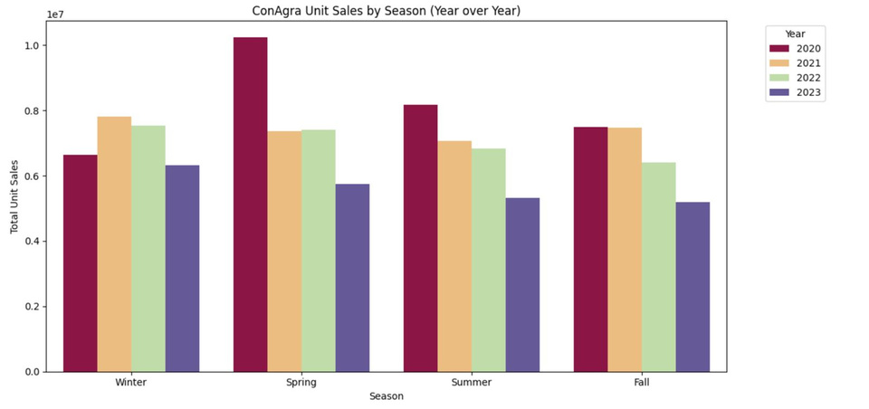
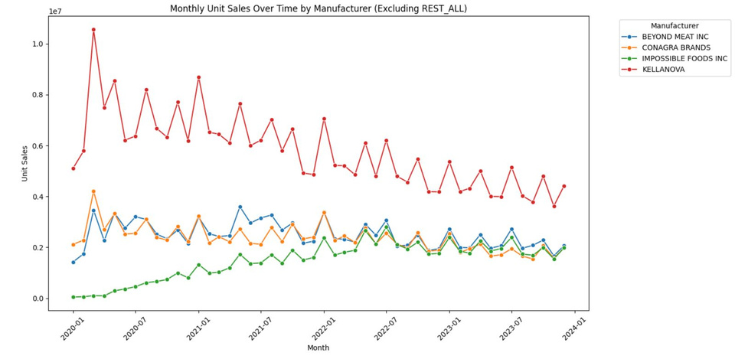
SEASONAL INSIGHTS & TRENDS
Strategic Implications for ConAgra
ConAgra must revitalize product offerings and campaigns, especially during Spring and Summer, to regain lost seasonal dominance.
Opportunity to diversify form and flavor portfolio and target segments where competitors are plateauing.
Leverage historical data to identify declining SKUs and reallocate resources to high-performing segments.
Consider differentiated pricing strategies and store-level promotions to capture price-sensitive buyers during key seasons.

Slide 9
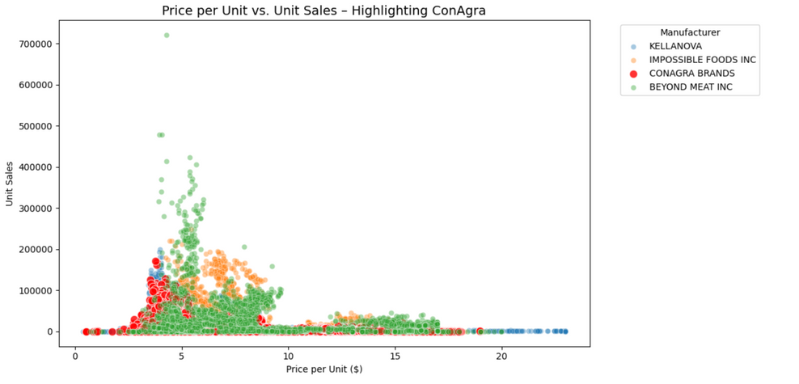
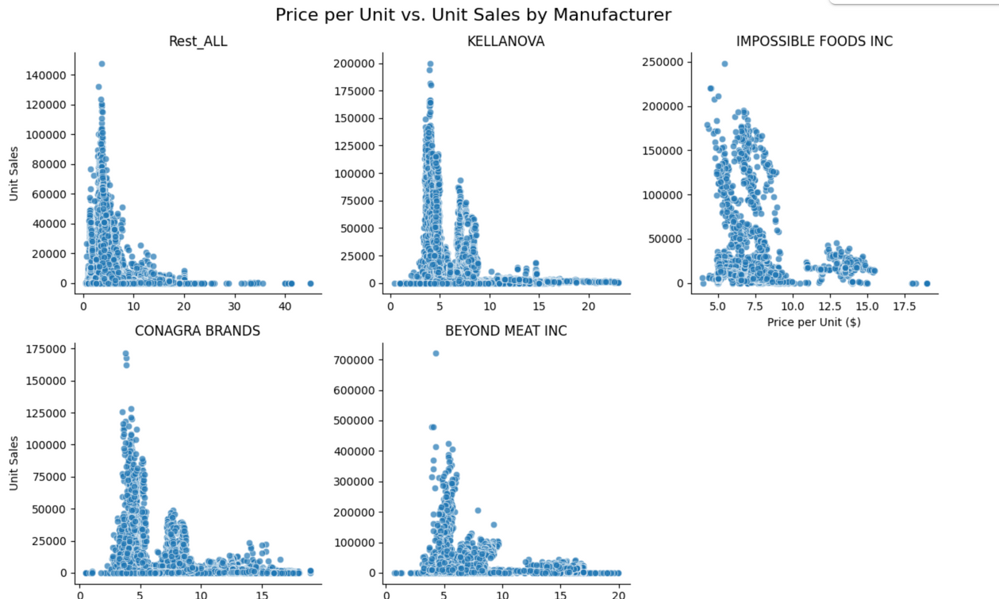
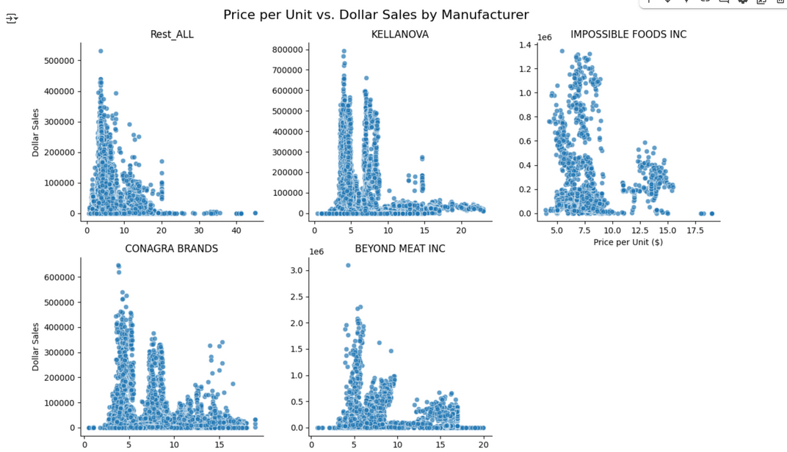
VISUALIZATIONS
Analysing Price Per Unit Sales For All Brands

Slide 10
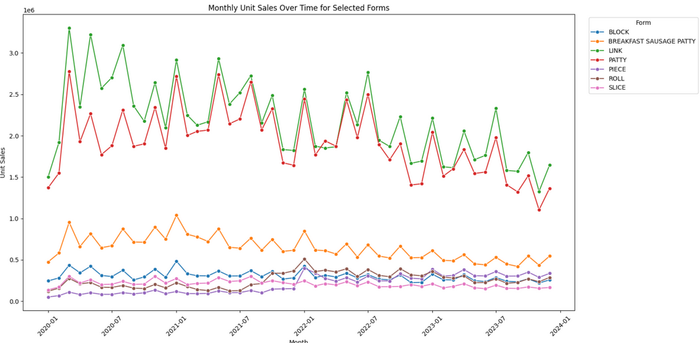
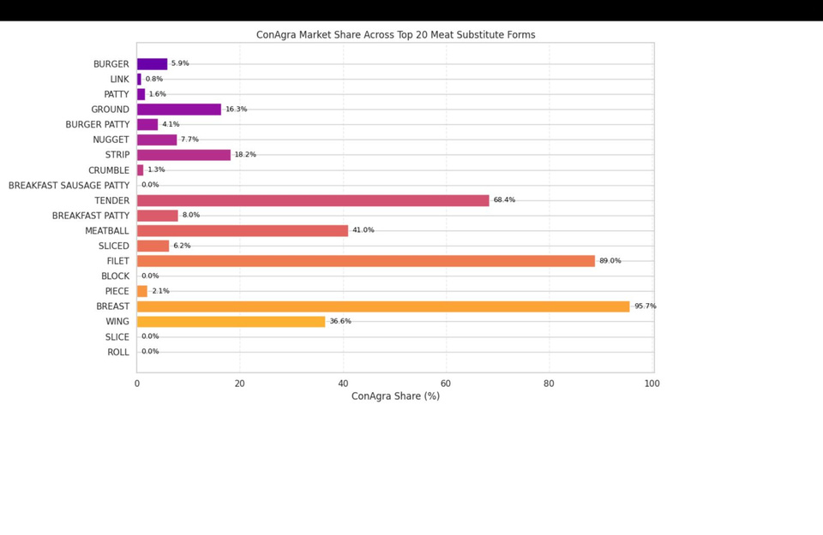
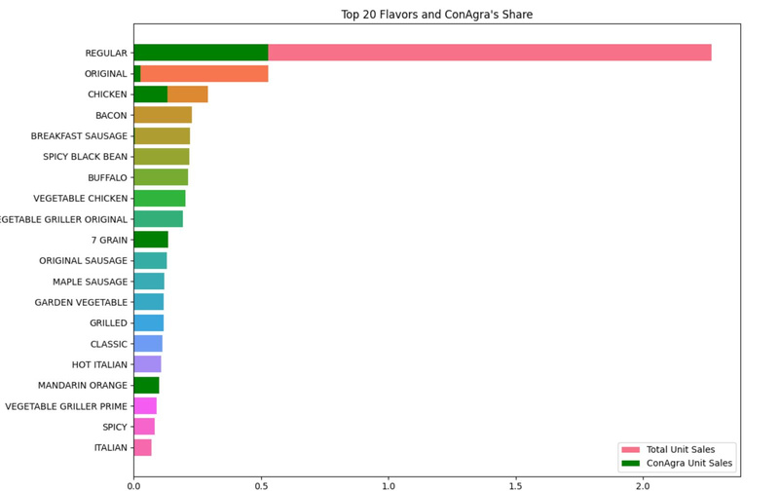
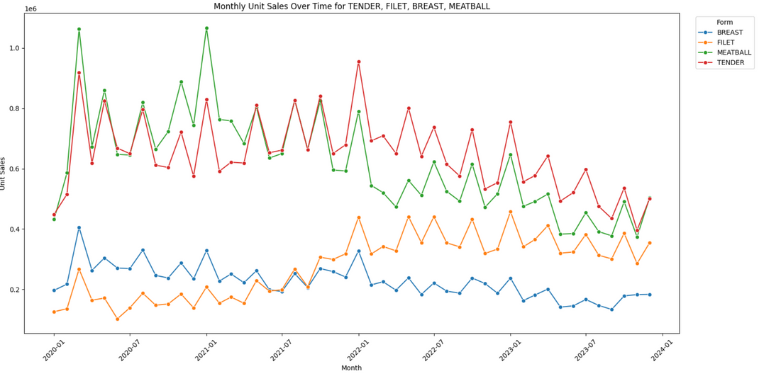
Analysing Forms And Flavors With Unit Sales Over The Years

Slide 11
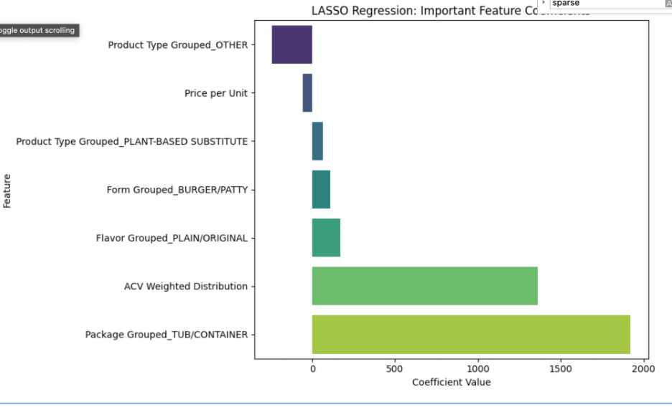
KEY FINDINGS FROM LASSO REGRESSION ANALYSIS:
TUB/CONTAINER packaging emerged as the strongest sales driver, with a coefficient of +1920, indicating significant impact on unit sales.
BURGER/PATTY form showed strong performance (coefficient +109), suggesting product form plays a key role in consumer purchase decisions.
PLAIN/ORIGINAL flavor contributed positively (coefficient +171), reinforcing the strength of core, familiar flavors.
The PLANT-BASED SUBSTITUTE product type had a smaller, but positive effect (+66), aligned with the broader trend toward plant-based eating.
Price per unit had a negative coefficient, highlighting price sensitivity among consumers.

Slide 12
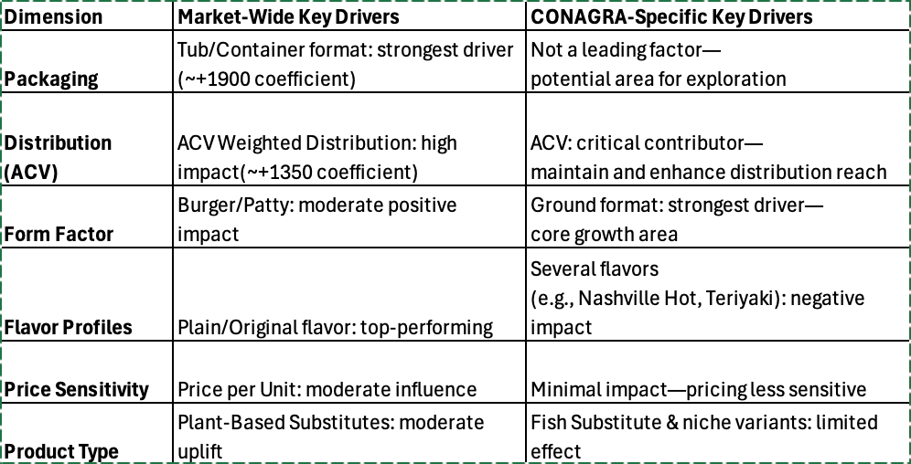
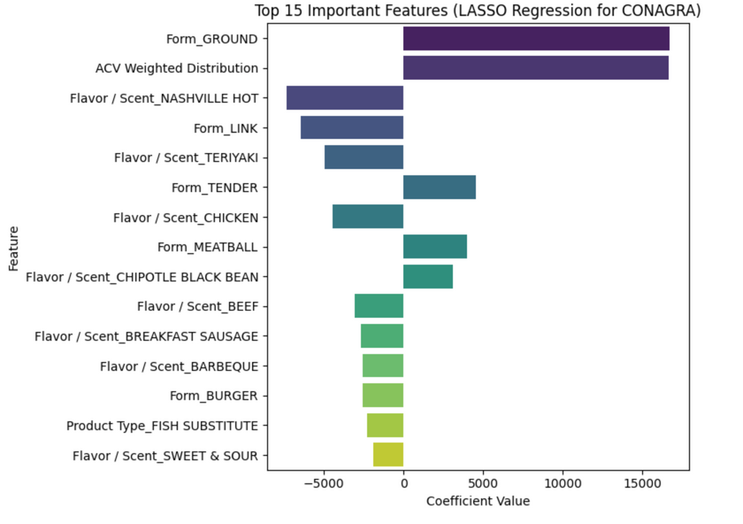
COMPARATIVE ANALYSIS FROM LASSO REGRESSION :

Slide 13

PREDICTORS
Key Elements for the Model
Form
Flavor
TARGET
Brand
Unit Sales
Availability of Product
Price Discount
Brand x Price Discount

Slide 14
Key Drivers of Sales
Predictor | Effect | Insight
Availability | 13.76 | Strong Driver - 1% increase in availability → 13.76 additional units sold
Price Discount | 1,292 | Strong Driver - 1% increase in price discount -> 1,292 additional units sold for the base brand (Beyond Meet)
Conagra x Price Discount | 167.4 | Discount is less effective for Conagra
Flavor: Plant Protein / Veggie | 1000 | Sells 1000 units more on average than the base flavor (Bbq)
Form : balls |  | Helps drive sales as all other forms either negatively impact sales or are insignificant

Slide 15
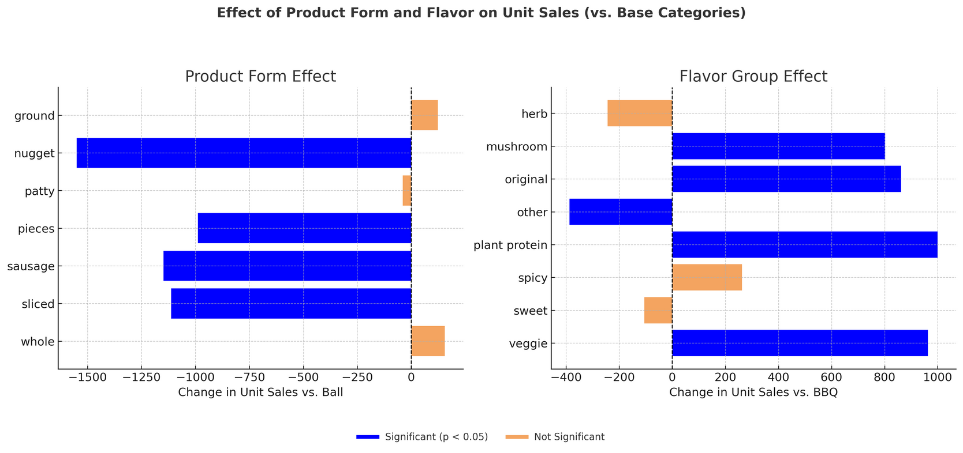
Strategy
Prioritize “Ball” form: It's the only form with a positive and statistically significant impact on unit sales.
Double down on successful flavors like veggie and plant protein, which perform ~1000 units better than the BBQ base.

Slide 16
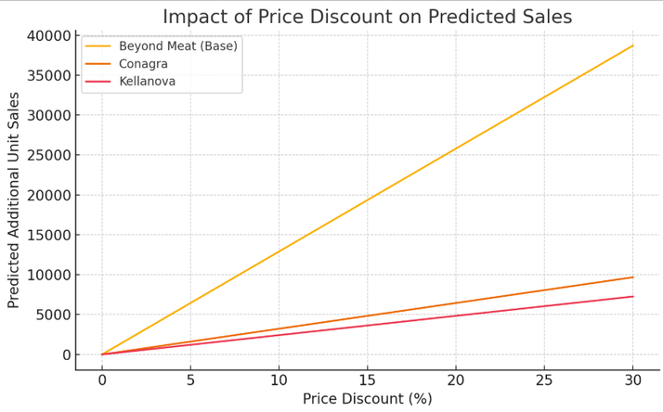
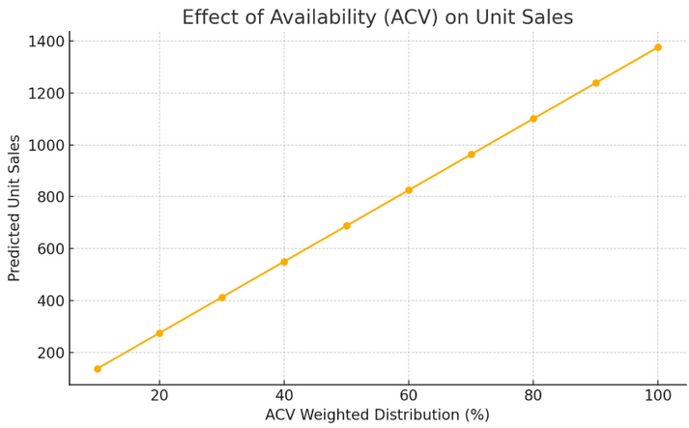
Strategy
Reconsider discount strategy: Conagra's discounting yields far lower returns than competitors (e.g., Beyond Meat).
Optimize promotions selectively in regions where Conagra has strong brand equity or complementary ACV strength.

Slide 17






Limitations
Multicollinearity due to interactions
Form
Too many Categories
Flavor
Large/non-interpretable coeffiecients
Brand
Grouping
Simpler Model

Slide 18
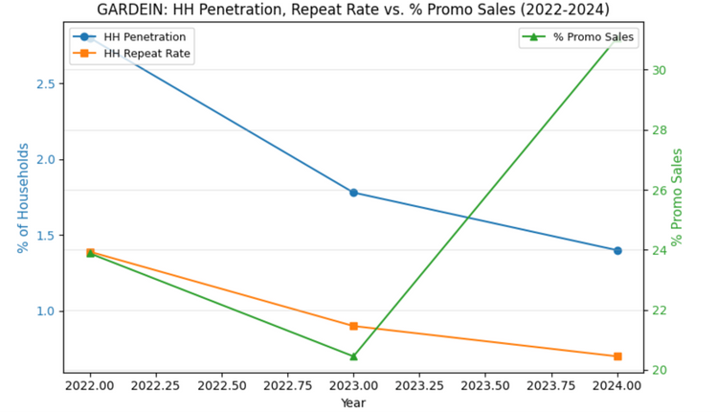
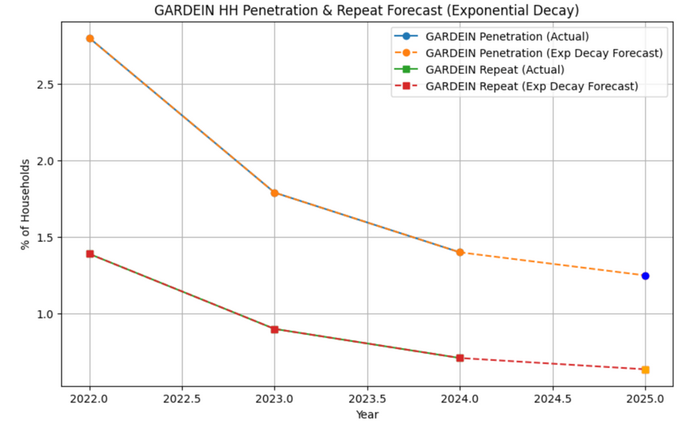
Household (HH) Trend Analysis
Insights:
GARDEIN’s household penetration declined from 2.8% in 2022 to 1.4% in 2024.
Repeat rate (HHs buying 2x+): fell from 1.4% in 2022 to 0.7% in 2024.
Comparatively, the broader Substitute Meat category saw penetration decrease from 19.6% to 14.3% over the same period, and repeat rate from 12.2% to 8.9%.
This indicates that while the overall category is declining, GARDEIN’s drop is steeper, signaling brand-specific challenges.
Promotional Activity Correlation:
The correlation between % promo sales and HH penetration was -0.45, and -0.47 for HH repeat rate. This suggests that despite ongoing promotions, household engagement has not strengthened and may be eroding.
Forecasting Insights:
A linear forecast projected GARDEIN HH penetration would drop to ~0.7% in 2025, with repeat down to ~0.5%.
However, using a more refined exponential decay model, penetration is expected to stabilize at ~1.25%, and repeat at ~0.64% in 2025.
This indicates that the brand’s decline may be slowing, offering a window to intervene.

Slide 19
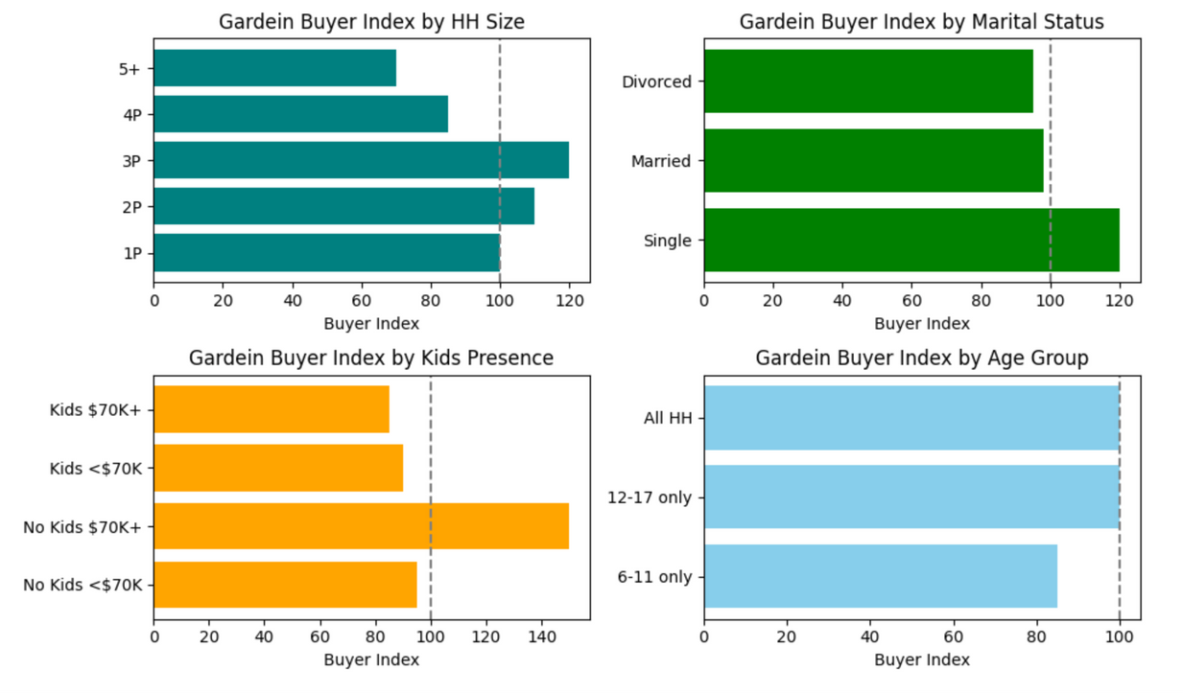
Gardein Buyer Index by Key Household Demographics
3-person HH are most engaged with Gardein (Index ~115).
5+ person HH are significantly under-engaged (Index ~70).
Business use: Target mid-sized families (3P/2P) more actively — they are core buyers.
Single buyers show the strongest alignment with Gardein (Index ~117).
Married and divorced households are near average (Index ~95–98).
No Kids, $70K+ = highest engagement (~150) — this is a key persona.
Kids <$70K or $70K+ = under-indexing (~85–90) — families with kids are less engaged.
Households with younger kids (6–11) buy Gardein less than average.
Teen households (12–17) are on par with the national average.

Slide 20
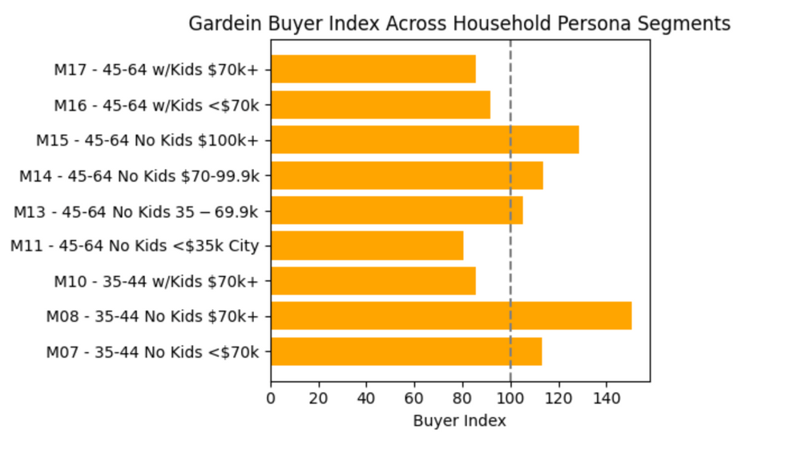
Identifying Gardein’s Strongest & Weakest Household Personas
Gardein thrives in - child-free households, particularly aged 35-64, showing up to 50% higher likelihood of buying than average.
While families with kids and good income are less engaged
Top-performing segments (strong buyers)
35-44 No Kids $70k+ ➔ ~150 Buyer Index
45-64 No Kids, higher income➔ ~130 & 115
Weaker-performing segments
45-64 No Kids <$35k City ➔ ~80
35-44 & 45-64 w/ Kids 70k+ ➔ ~85-90

Slide 21
RECOMMENDATIONS
Focus on High-Performing Segments:
Target child-free households (35–44, 45–64) with $70K+ income.
Prioritize urban, no-kids professionals who show up to 50% higher purchase likelihood.
Action:
Tailor messaging & campaigns to highlight convenience, health benefits, and versatile usage.
Optimize Product Strategy:
ACV Weighted Distribution: Maximize shelf presence & reach.
Package Type (Tub/Container): Leverage popular formats.
Form (Ground, Burger/Patty): Focus on high-impact SKUs.
Prioritize retention strategies : to stabilize core buyers—loyalty initiatives and personalized offers are essential to counteract the expected decline in penetration and safeguard market share through 2025.

